Slide 1
BHUMI @ aiabs
Where Cloud Meets Bhumi

Slide 2
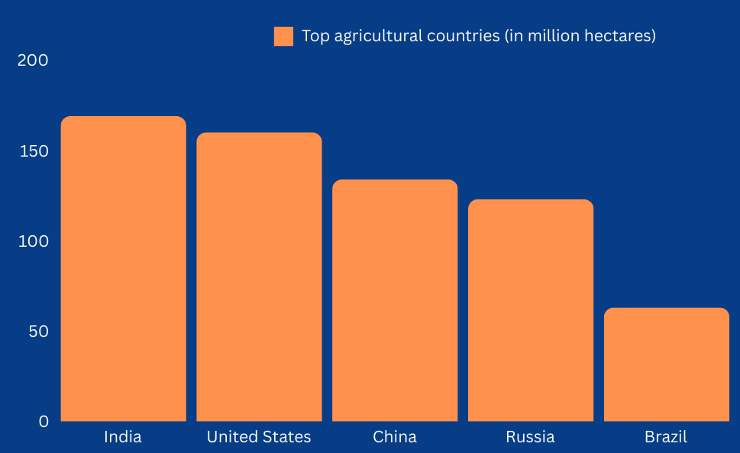
India's Agricultural Paradox
Largest agricultural land globally
60% of population in agriculture.
3,493 Agritech startups in India
Yet, facing challenges in productivity and farmer income

Slide 3
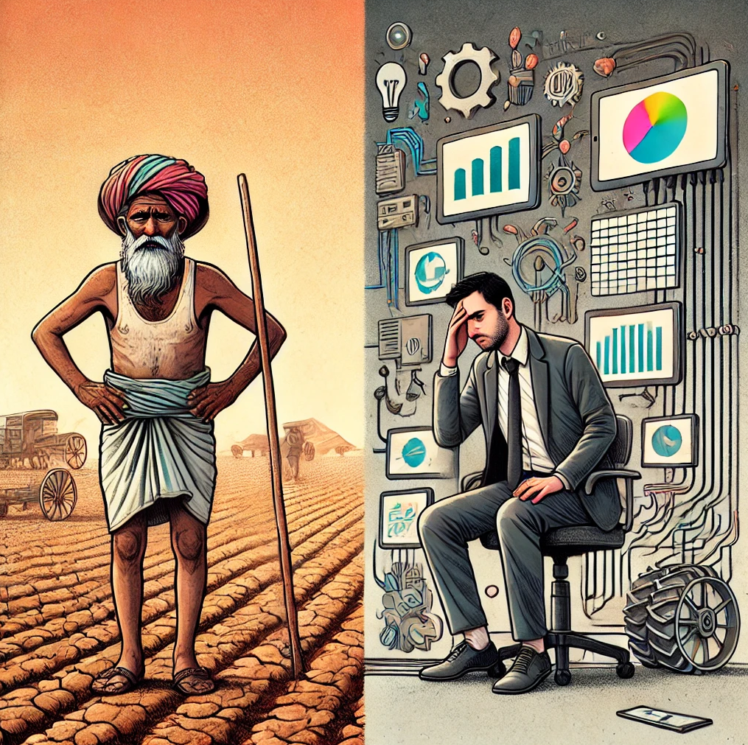
What is the Problem?
No reliable data source.
No Realtime high granularity data collection.
From Indian Agritech: No innovation worth deploying.
From Abroad Startups: Too complex to adopt in Indian market.

Slide 4
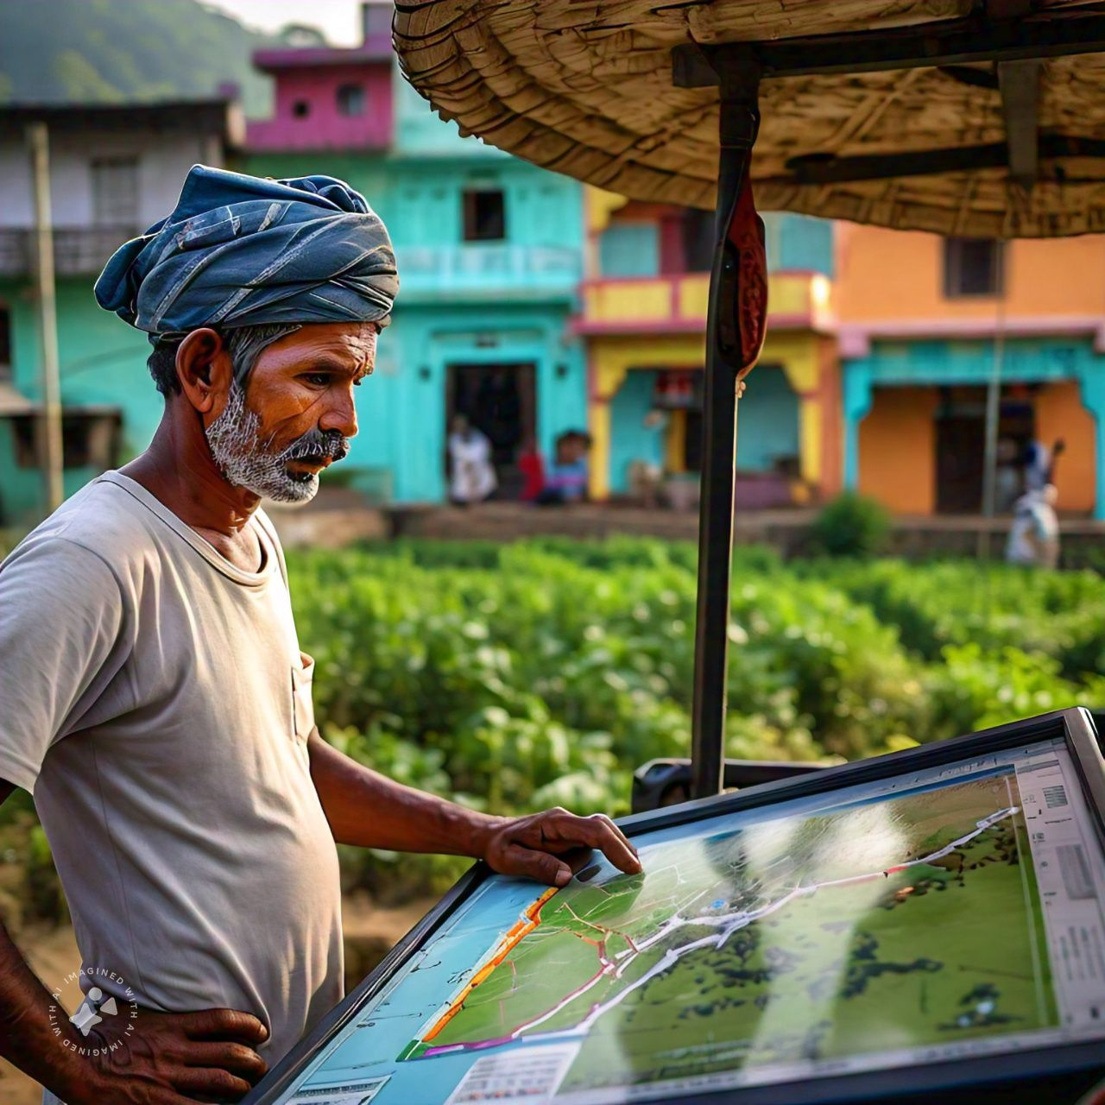
Why Bhumi?
Remember the previous slide, Bhumi will take care of it.
Real-time WebGIS-enabled soil mapping interface.
GenAI-powered crop recommendations & virtual inspections
Voice-activated analytics
Developer API access
Built-in marketplace for Agri-Apps

Slide 5
Realtime Data, How?
I know, hear me out, you'll love it.
Here comes "Dhruva" and below are it's features:
Autonomous data collection.
Equipped with sensors required for soil data collection.
Ability to work in swarm.
Easy to use.

Slide 6
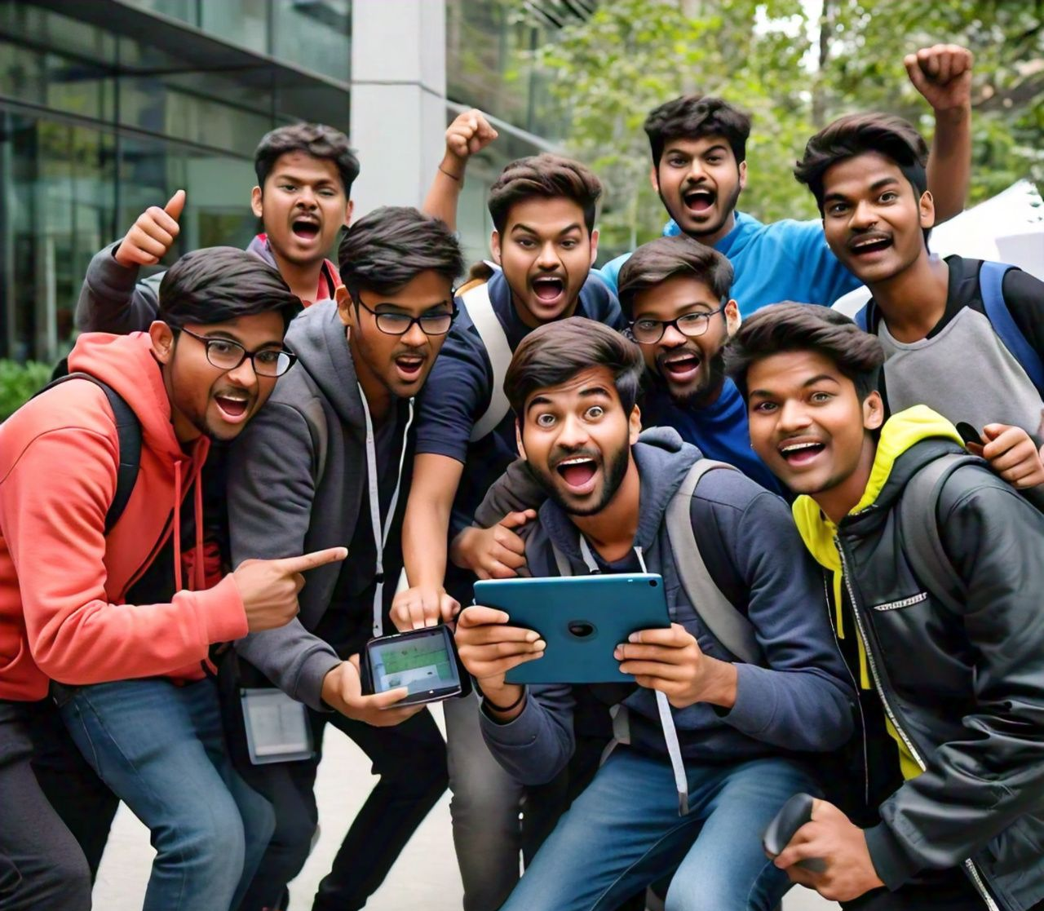
Who operates Dhruva?
Phase 1: Utilize tech savvy humans (for now:) for scanning our pilot farms and land.
Phase 2: We scale strategically to cover more land.
Scan-to-Earn Program
School & College Partnerships
Kisan Drone Corps
This is our initial plan and we are not done.
More is coming!

Slide 7
Why we are building all this?
Our Mission: Automate agriculture from Farm to Table
Building Blocks:
Real-time farm data
AI crop assistant
Voice-activated analytics
Developer API & marketplace
Future Innovations:
Autonomous farm AI systems
Agricultural reasoning LLM
Expansion to medicine and defense
BHUMI: Sowing the seeds of a data-driven revolution across industries.

Slide 8
Business Model
🌱 Farmer Subscriptions
Freemium model:
Basic (free): AI-driven insights, crop recommendations, weather alerts (Only for their farm).
Premium tiers: Access to all data (For Farms under "Farmer Data Sharing Program").
💹 Data Marketplace
Sell aggregated farm data to agribusinesses, researchers, and gov't agencies.
Tiered pricing based on data complexity and volume.
🖥️ Developer Ecosystem
API access with free and paid tiers.
Revenue sharing for apps built on Bhumi platform.
🏢 Enterprise Solutions
Customized analytics for large agribusinesses
Supply chain optimization and yield prediction

Slide 9
Market Opportunity
Given our technology's comprehensive scope, precise market estimates are premature. However, based on our Phase 1 plans, we project:
Indian AgriTech market valued at $10.9 billion in 2023
Expected to reach $24 billion by 2025
CAGR of 37.5% from 2023 to 2025

Slide 10
What will we accomplice with seed?
Product:
Launch BHUMI platform beta
Develop farmer mobile app MVP
Achieve 75% accuracy in crop yield predictions
Market Traction:
Onboard 10,000 farmers
Scan and analyze 10,000 acres
80% user retention rate
Data & Innovation:
Collect 1 million unique data points
Initiate 1 university research collaboration
Team & Operations:
Expand to 5 core team members and 10 support.
Establish presence in 2 major agricultural states
Financial:
Generate ₹10,000,000 (~$125,000 USD) initial revenue
Position for Series A funding

Slide 11
Who are we?
Harsh Tiwari (Founder And Chief AI Engineer)
Passionate researcher and engineer with 8+ years in software and AI development.
On my way to pursue research collaboration with an IIT.
Focus: Data-driven simulations for Reinforcement Learning in Agriculture
Expertise bridging academic research and practical AI applications
Our work at AIABS and my research are laying the groundwork for transformative AI applications
Manish Kumar Singh (CBDO)
Our team includes a seasoned Business Development Manager with 9+ years of experience in procurement and finance, complemented by a strong agricultural background. This expertise is crucial for BHUMI's growth from Business Development side.
We are in talks with experts in WebGIS, Robotics and Mechatronics, with your support we can make this reality.

Slide 12
What do we ask?
Seeking a visionary partner to fuel BHUMI's growth and revolutionize agriculture. Remember, yesterday's 'impossible' is today's reality—just look at quick commerce. Let's make AgriTech the next big disruption.
Help us build our dream.

Slide 13
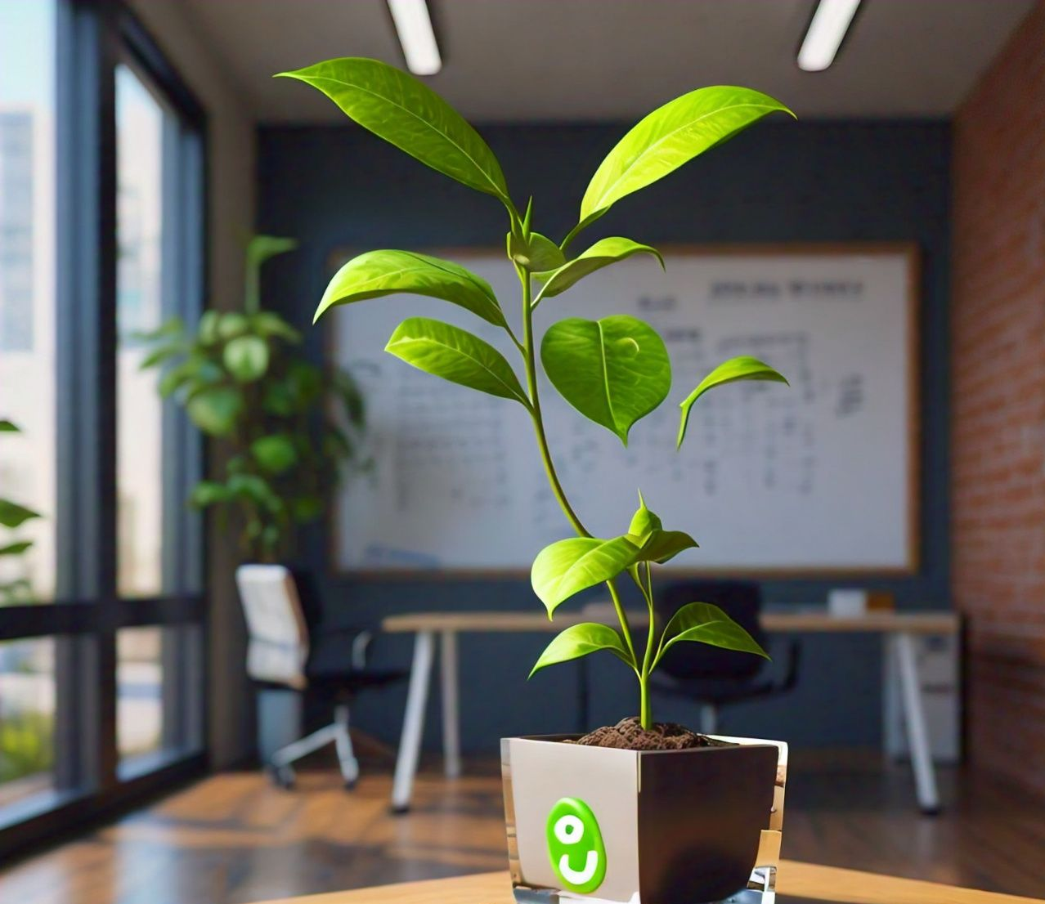
Any Questions?

